Slide 1

PLACEMENT MANAGEMENT SYSTEM
Submitted By Under the guidance of
1.Nitin Yawale Pooja Mehta
2.Sakshi Hande
3.B Tejswini
4. K Prasanna Kumar

Slide 2
ITRODUCTION
In today’s modern, sophisticated and fast world , online PLACEMENT MANAGEMENT have become a medium of communication among the internet users . On one end it is informative , convenient and cost effective. ONLINE PLACEMENT MANAGEMENT focused on building online communities of people having shared interests. PLACEMENT CELLS have common themes of providing best jobs, person-to-company interaction and creation of shared and collaborative content.

Slide 3
PROJECT OBJECTIVE
Help in fast access producers in placement related activities.
facility of maintaining the details of the students
Time Saving
Easy to access . Avoid fake entry.
Only Eligible student get chance. Improve accuracy in result.
The proposed system intends user-friendly operations which may resolve ambiguity.

Slide 4
PLACEMENT CELLS BENIFITS
A placement Cell site can be good way to make connections with people with similar interests and goals.
Facilities open communication, leading to enhanced job information discovery and delivery .
Build new connection, awareness and company response.

Slide 5
Provides an opportunity to widen business contacts.
Convenient and easy to use .
Placements Cells site provides different categorized job opportunity. It also allow user their user to upload their resume.

Slide 6
TECHNOLOGIES USED
Java 8
Spring Boot 2.2.6+
Spring Framework 5.2.5+
Maven 3.2
Spring Data JPA(Hibernate)
MySQL
Thymeleaf

Slide 7
REQUIRED SPECIFICATION
Hardware Configuration | Software Configuration
System: P IV or above | Software IDE : Eclipse
RAM : 1 GB Hard Disk : 10 GB | Language : Java
Operating System : Windows 8 & above | Back End : My SQL Server

Slide 8
PROPOSED SYSTEM
The aim of the proposed system is to develop a system with improve facilities. Our project has big scope to do. Student can access previous information about placement . We can store information of all students. Various companies can access their information . Notifications are sent to student about the companies.
The proposed system can overcome all the limitation of the existing system , such as student’s information is maintained in the database, it gives more security to data , insure data accuracy, only eligible student get chance,it makes information flow efficient.

Slide 9
SPRING ANNOTATIONS
@Controller: The @Controller is a class-level annotation. It is a specialization of @Component. It marks a class as a web request handler. It is often used to serve web pages. By default, it returns a string that indicates which route to redirect. It is mostly used with @RequestMapping annotation.
@Autowired: Spring provides annotation-based auto-wiring by providing @Autowired annotation. It is used to autowire spring bean on setter methods, instance variable, and constructor. When we use @Autowired annotation, the spring container auto-wires the bean by matching data-type.
@Configuration: It is a class-level annotation. The class annotated with @Configuration used by Spring Containers as a source of bean definitions.
@Bean: It is a method-level annotation. It is an alternative of XML <bean> tag. It tells the method to produce a bean to be managed by Spring Container.
@Service: It is also used at class level. It tells the Spring that class contains the business logic.

Slide 10
SPRING ANNOTATIONS
@Repository: It is a class-level annotation. The repository is a DAOs (Data Access Object) that access the database directly. The repository does all the operations related to the database.
@EnableAutoConfiguration: It auto-configures the bean that is present in the classpath and configures it to run the methods. The use of this annotation is reduced in Spring Boot 1.2.0 release because developers provided an alternative of the annotation, i.e. @SpringBootApplication.
@SpringBootApplication: It is a combination of three annotations @EnableAutoConfiguration, @ComponentScan, and @Configuration.
@RequestMapping: It is used to map the web requests. It has many optional elements like consumes, header, method, name, params, path, produces, and value. We use it with the class as well as the method.
@GetMapping: It maps the HTTP GET requests on the specific handler method. It is used to create a web service endpoint that fetches.

Slide 11
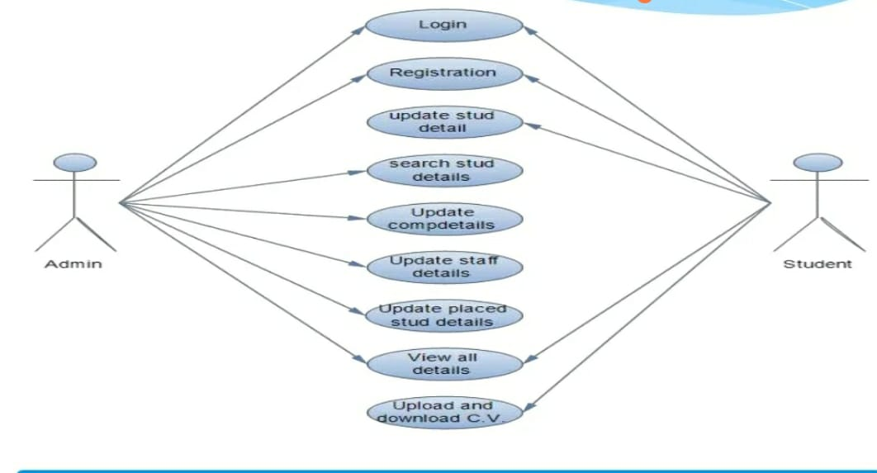
USE CASE DIAGRAM

Slide 12
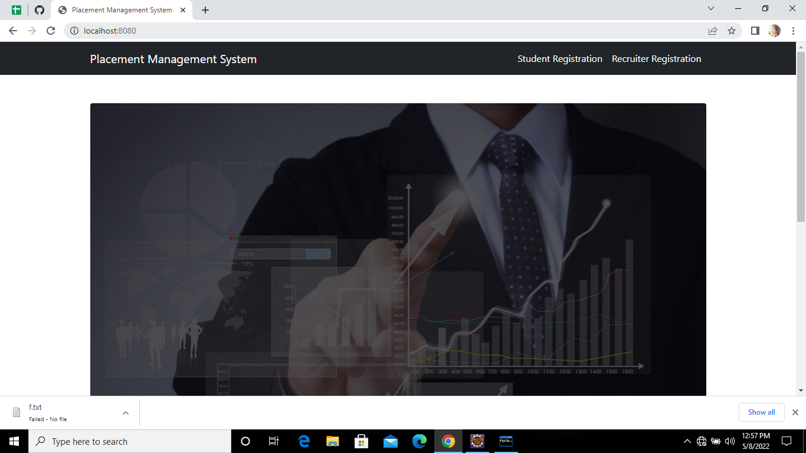
Home Page

Slide 13
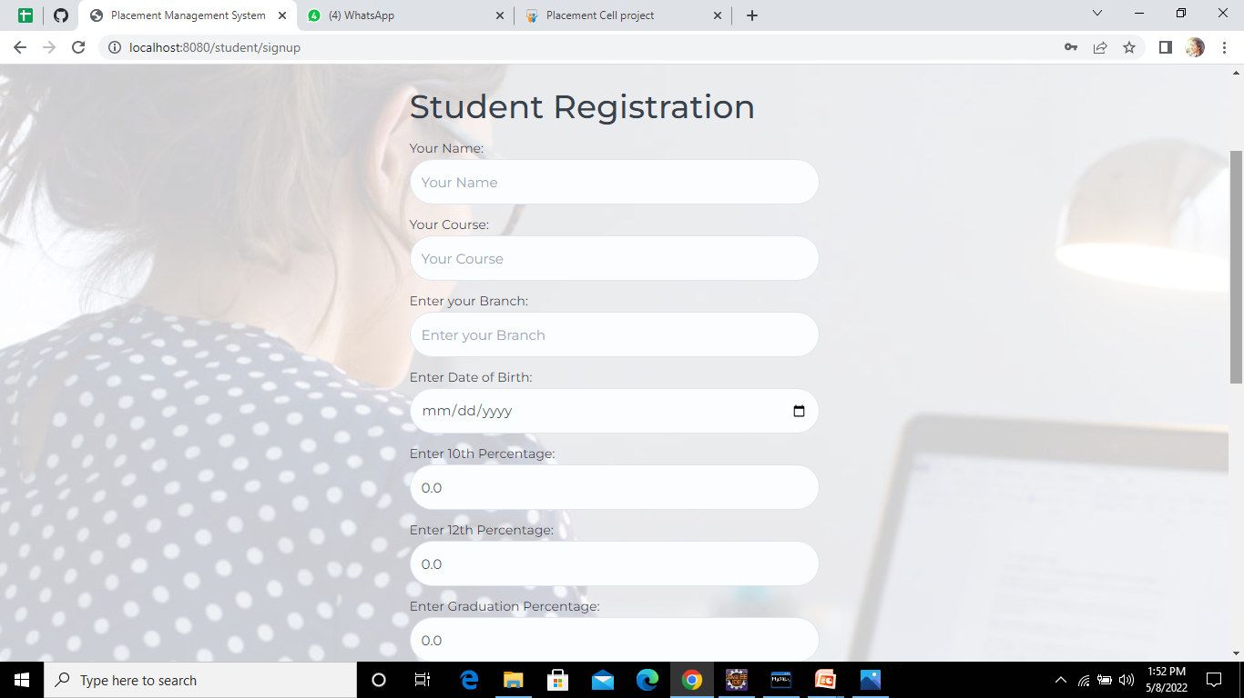
STUDENTS REGISTRATION

Slide 14
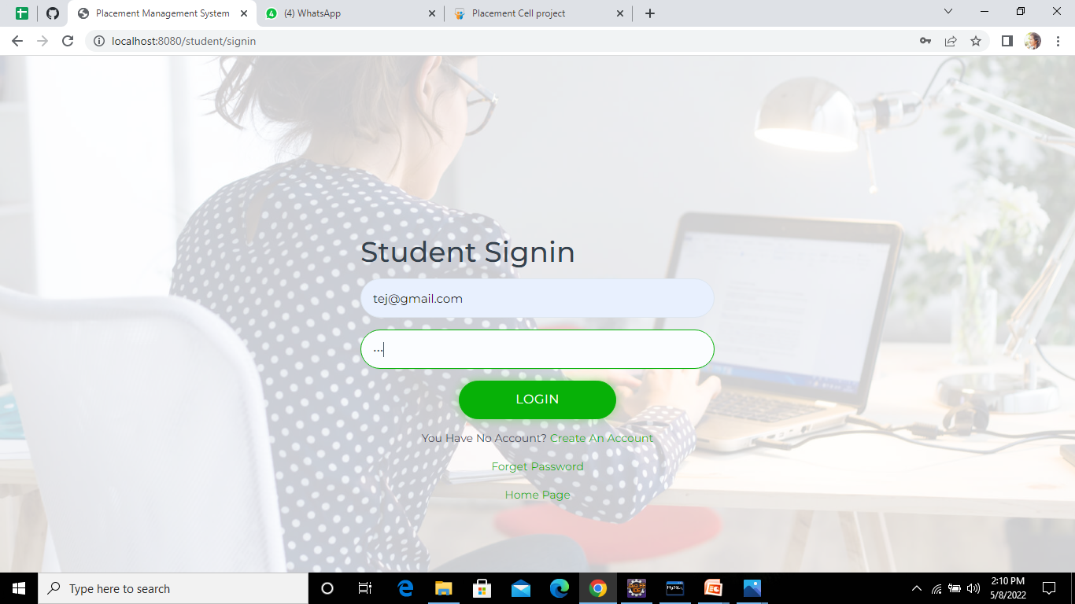
STUDENTS LOGIN

Slide 15
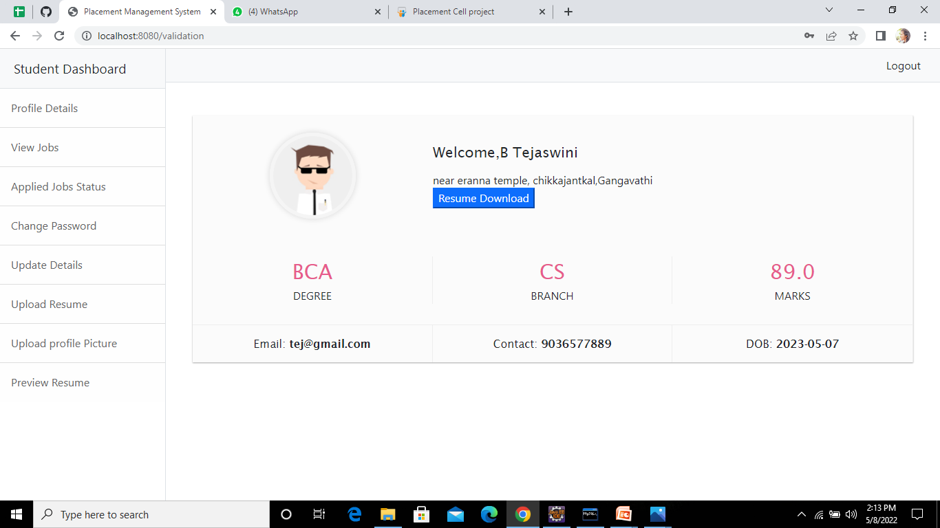
STUDENT PORTAL

Slide 16
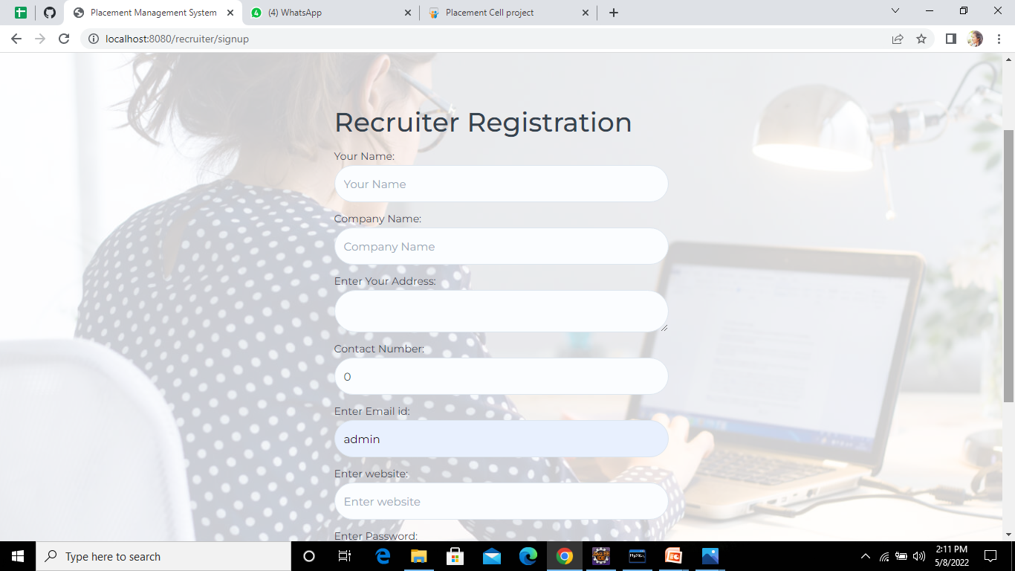
RECRUITER REGISTRATION

Slide 17
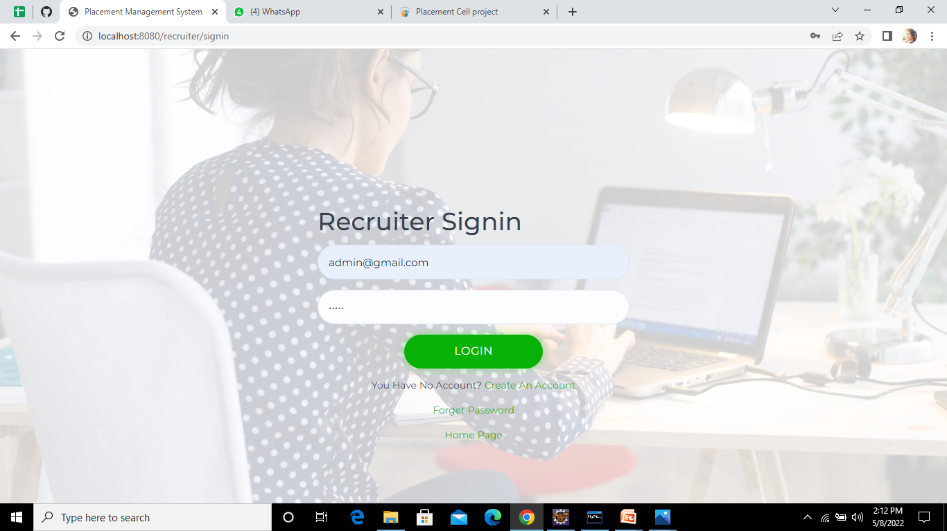
RECRUITER LOGIN

Slide 18
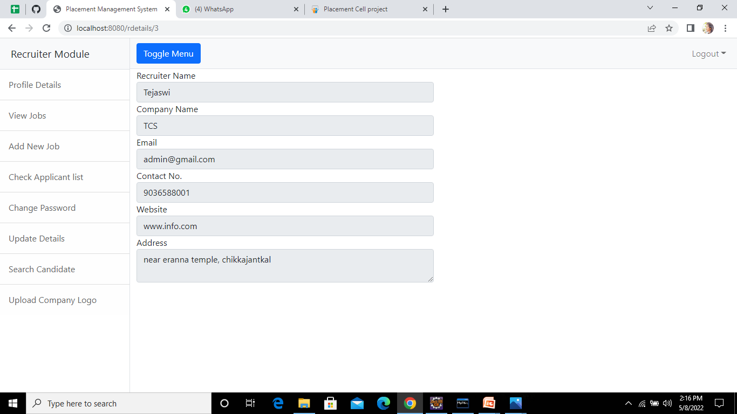
RECRUITER PORTAL

Slide 19
CONCLUSION
The placement system facilitates the process of placement of students passing out from the institute.
This component can be easily plugged in many other system . Also the component is user friendly.
Accurate information is available.
Web based placement management system by maintaining the student details related to placement in an efficient manner.
Provides security to the system and software.

Slide 20


